Slide 1
Lawyer LLaMA Technical Report

Slide 2
Summary
This paper focuses on the legal domain called Lawyer LLaMA by injecting domain knowledge during continual training, designing supervised finetune tasks to address practical issues, and introducing a retrieval module to enhance the model's response reliability by extracting relevant articles.
LLaMA = Large Language Model Meta AI
2

Slide 3
Contents
Background and Contribution
Data Collection
Training Process
Experiments
Conclusion and Future Works
3

Slide 4
Contents
Background and Contribution
Data Collection
Training Process
Experiments
Conclusion and Future Works
4

Slide 5
Background
Open-source large language models (LLMs) like Vicunna and ChatGLM have achieved remarkable performance in general tasks, but adapting them to specific domains like law is challenging due to the scarcity of domain-specific data and training methods.
LLMs are mainly trained on general corpora like Common Crawl and Wikipedia, lacking domain-specific knowledge required for specific domains.
Analyzing and solving legal domain tasks may significantly differ from general domains, posing challenges for LLMs applying their knowledge to practical legal issues.
Therefore, a LLM model is needed to apply legal knowledge correctly and solve practical problems in the legal domain.

Slide 6
Contribution
The main contribution is to the development of Lawyer LLaMA (Chinese law), a large language model specifically designed for the legal domain.
It explores by injecting domain knowledge during continual training and designing proper supervised finetune tasks to enhance the model's performance in the legal domain.
It also introduces a law article retrieval module to improve the reliability of the model's responses.

Slide 7
Contents
Background and Contribution
Data Collection
Training Process
Experiments
Conclusion and Future Works
7

Slide 8
Pre-training Corpus
In order to enhance the performance of the LLaMA model for Chinese legal consultation, two different corpora are used for continuous pre-training.
Multilingual general corpus: This corpus helps the model to enhance its ability to represent Chinese.
Chinese legal corpus: This corpus helps the model to augment its legal knowledge.

Slide 9
Multilingual General Corpus
The original LLaMA model always generates English responses to Chinese queries, which may also be irrelevant.
To address this issue, the researchers continually pre-train LLaMA on the Chinese general corpus, which includes articles from WuDaoCorpora, CLUECorpus2020, and the Simplified Chinese edition of Wikipedia.
The WuDaoCorpora is a large-scale Chinese corpus that includes various genres, such as news, web pages, and forums.
The CLUECorpus2020 is a benchmark dataset for Chinese language understanding and evaluation, which includes various tasks such as text classification, named entity recognition, and machine reading comprehension.
The Simplified Chinese edition of Wikipedia is a widely used online encyclopedia covering various Chinese topics.
The C4 Corpus is a large-scale English corpus that includes web pages, books, and other sources of text.

Slide 10
Chinese Legal Corpus
To incorporate Chinese legal knowledge into their model, the authors of this paper collected articles from the websites of China Courts, including judgment documents, law articles, judicial interpretations, and other relevant sources.
The purpose of gathering this corpus of Chinese legal material is to improve the model's performance on tasks related to Chinese law.

Slide 11
National Judicial Examination
The National Judicial Examination is a test that individuals must pass in order to become certified as a lawyer or a judge.
A model called JEC-QA is used to practice the legal domain by answering questions from the exam.
However, JEC-QA does not provide any explanations for the answers to these questions.
To address this issue, ChatGPT is used in the language model, to provide an explanation for every answer in the JEC-QA dataset.

Slide 12
Legal Consultation
An open-source dataset of legal consultation is used for sampled seed questions using ChatGPT.
They collected both one-turn responses and multi-turn dialogues with well-crafted prompts.
To improve the faithfulness of the generated responses, a law article retrieval component is adopted to search related law articles.

Slide 13
One-turn Responses
One-turn responses refer to situations where the model generates a single response to a given prompt or question.
The authors list six requirements for generating one-turn responses as a lawyer, including
Properly citing law articles,
Provide well-founded analyses based on facts and law,
Comprehensive responses,
Asking relevant questions,
Using plain language, and
Giving preliminary legal opinions and consulting conclusions.

Slide 14
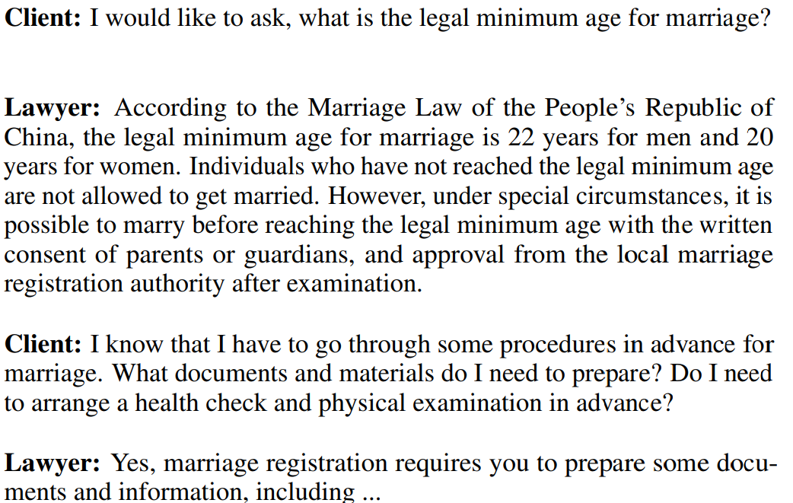
Multi-turn Dialogues
Multi-turn dialogues refer to conversations that involve multiple exchanges between two or more parties.
In this case, the two parties are the client and the lawyer, and ChatGPT is being used to simulate both roles.

Slide 15
Retrieval Augmented Generation (1/2)
Retrieval augmented generation involves using a retrieval module to provide relevant articles to a language model during the generation of responses.
Hallucination refers to the phenomenon where ChatGPT generates responses that are either outdated or do not exist in the legal domain.
To alleviate this problem, the authors propose a technique called "Retrieval Augmented Generation" that involves providing related law articles to ChatGPT.
The authors use a law article retrieval model to select the top 3 related law articles to the input prompt for a one-turn response.
For a multi-turn dialogue, the authors assume that the topic of the conversation will not change and use the same 3 law articles across the dialogue.
15

Slide 16
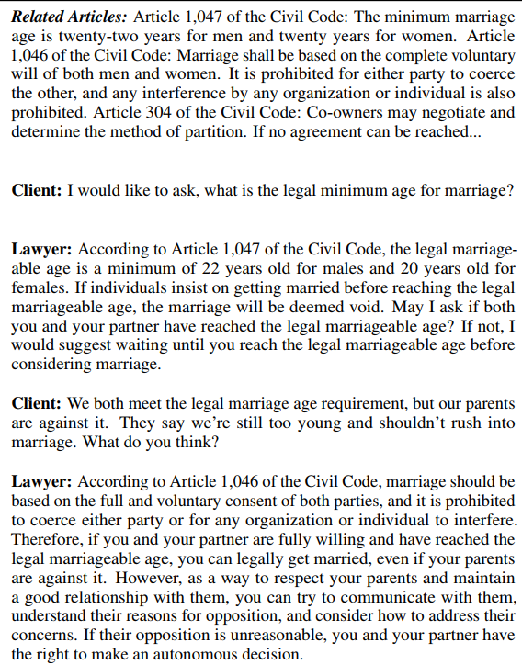
Retrieval Augmented Generation (2/2)
16

Slide 17
Contents
Background and Contribution
Data Collection
Training Process
Experiments
Conclusion and Future Works
17

Slide 18
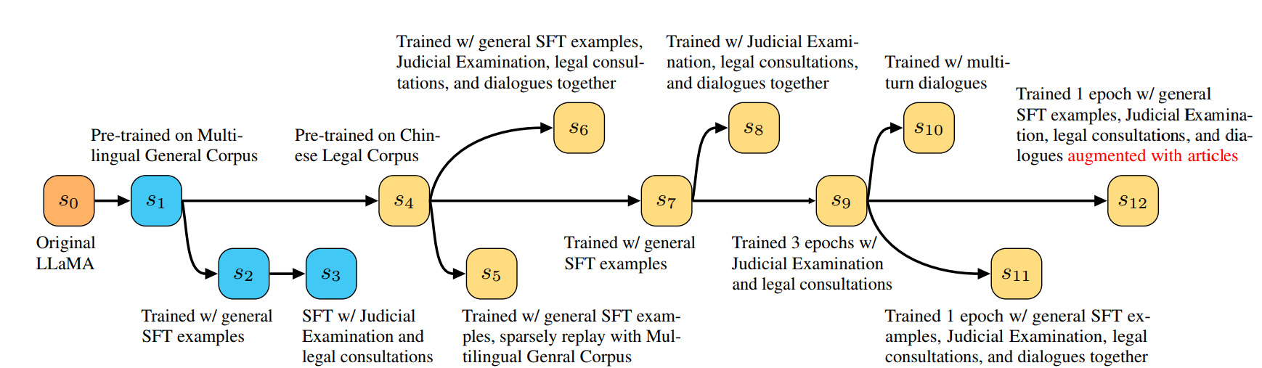
Training Process (1/2)
The figure shows the training process of Lawyer LLAMA, a large language model (LLM) for legal applications.
The LLM is first pre-trained on a multilingual general corpus, which gives it a foundation in language and understanding.
It is then pre-trained on a Chinese legal corpus, which gives it specific knowledge of Chinese law.
18

Slide 19
Training Process (2/2)
The figure shows the 12 training stages of Lawyer LLAMA.
The first stage is the pre-training on the multilingual general corpus.
The intermediate stages are the fine-tuning on the SFT examples, the Judicial Examination, the legal consultations, and the dialogues augmented with articles.
The final stage of the training process is to train the LLM on multi-turn dialogues.
The LLM is fine-tuned on each of these data sets for one epoch.
19

Slide 20
Enhancing LLaMA’s Ability in Chinese
To improve LLaMA's comprehension and generation ability in Chinese, the authors continually pre-train it on a mixture corpus of Chinese and English text.
The authors also address two challenges:
Chinese characters not included in LLaMA's vocabulary: The vocabulary of LLaMA was not changed, as the prior study showed that expanding the vocabulary does not seem to bring further improvement on downstream Chinese NLU tasks.
Whether to pre-train on Chinese corpus solely or to add texts in English: They decide to use a mixture corpus of both English and Chinese, because they believe that many complex reasoning abilities may come from the pre-training on English.
20

Slide 21
Injecting Legal Knowledge
The limitation is the LLaMA model lack of legal knowledge, which is a problem when the model is used in the legal domain.
To overcome this limitation, researchers gathered a variety of plain Chinese texts, such as law articles and judicial interpretations, for further training.
In addition to the legal texts, the authors also added general texts to the training data to prevent the model from overfitting the legal corpus.
21

Slide 22
Learning Reasoning Skills
Reasoning skills can be learned by training models on supervised data from downstream tasks and using instruction-tuning methods.
Collecting question-answer pairs and asking the model to provide detailed explanations during training helps in developing reasoning skills.
In order to train the algorithm to deliver precise answers to particular queries, real-world lawyer queries are used.
22

Slide 23
Retrieving Relevant Law Articles
Retrieving relevant law articles can be achieved by incorporating a law article retrieval module into the model.
To train the retrieval module, user questions for legal consultation are collected and legal professionals annotate up to 3 necessary law articles to answer each question.
A law article retrieval model based on RoBERTa is trained, which achieves high recall rates on the testing set.
Previous research has identified law articles from factual descriptions in judicial documents, but due to variances in user queries, these classifiers may not perform well in real-world scenarios.
To address the issue of irrelevant information, irrelevant articles are added to the training context, forcing the model to ignore them.
The model receives a warning during inference about possible irrelevant legal articles, encouraging it to ignore such citations from its answers.
23

Slide 24
Contents
Background and Contribution
Data Collection
Training Process
Experiments
Conclusion and Future Works
24

Slide 25
Experiments
The experiments are conducted to evaluate the zero-shot performance of Lawyer LLaMA, which is a generative dialogue model.
The experiments involved transferring every employed task to a multiple-choice task to evaluate the model's performance at different training stages.
The model was tested without any fine-tuning on specific tasks, and it predicted the answer by choosing a text with the lowest perplexity.
The experiments were conducted on LLaMA-7B, which is a specific version of the Lawyer LLaMA model.
The experiments are conducted based on:
Evaluation on General Tasks
Evaluation on Chinese Legal Tasks
25

Slide 26
Evaluation on General Tasks
The authors evaluate the model on general tasks involving continuously training it on different corpora or with different supervised-fine-tuning datasets.
They find that pre-training on a multilingual general corpus can enhance the model's ability to represent Chinese without sacrificing its ability to represent English with an improvement of 5.3% accuracy.
Fine-tuning the model with Judicial Examination examples and legal consultations improves its ability to handle the Chinese NLI task, with an improvement of up to 9.3% accuracy.
However, the model fails to handle English NLI and sentiment analysis tasks, possibly due to a lack of sufficient supervised fine-tuning examples for these tasks.
Overall, the results of this evaluation suggest that continual training can improve LLaMA's ability to solve general NLP tasks, but that the specific tasks that the model can improve on depend on the corpora and datasets that it is trained on.
26

Slide 27
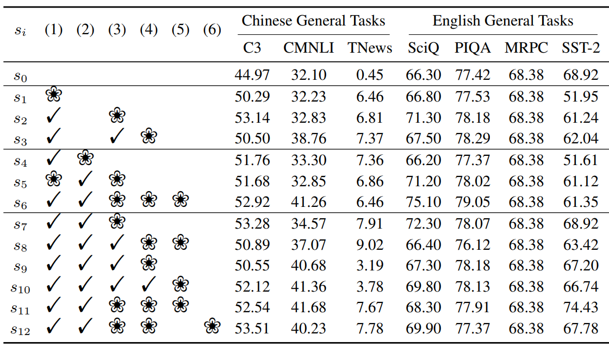
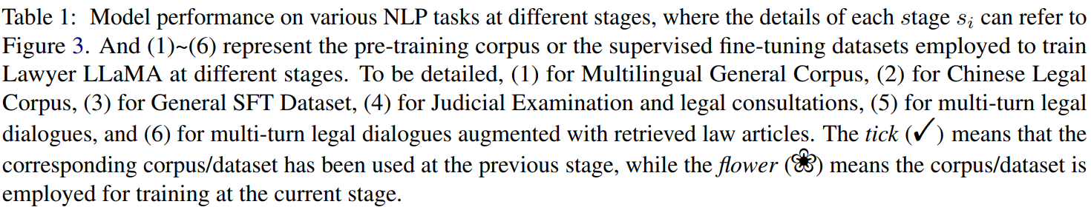
Evaluation on General Tasks
LLaMA obtained an improvement of +5.3% accuracy on C3 obtained
Chinese NLI task, with an improvement of up to 9.3% accuracy.
27

Slide 28
Evaluation on Chinese Legal Tasks (1/5)
The model is evaluated on Chinese legal tasks by constructing multiple-choice tasks based on the objective questions of the Chinese Judicial Examination (JE).
The evaluation focuses on two parts: Concept Discrimination (JE-C) and Scenario Planning (JE-S).
The model's ability to solve tasks related to the Law of Marriage is also examined by predicting the causes of action for judgment documents from the website of China Courts.
Verdicts about marriage are used to construct a 4-class task (CAM), and verdicts about property are used for a 10-class task (CAP).
The results of each Chinese legal task are listed in Table 2, showing the model's performance at different training stages.
The evaluation also compares the model's performance on different datasets, such as the Chinese Legal Corpus and legal consultation datasets
28

Slide 29
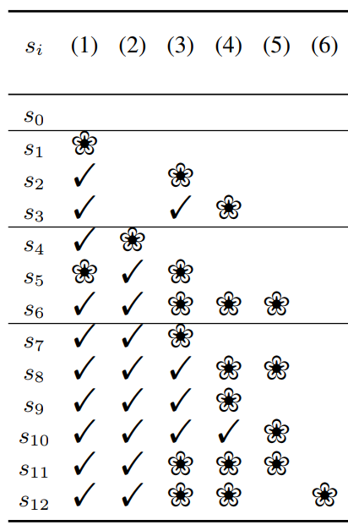
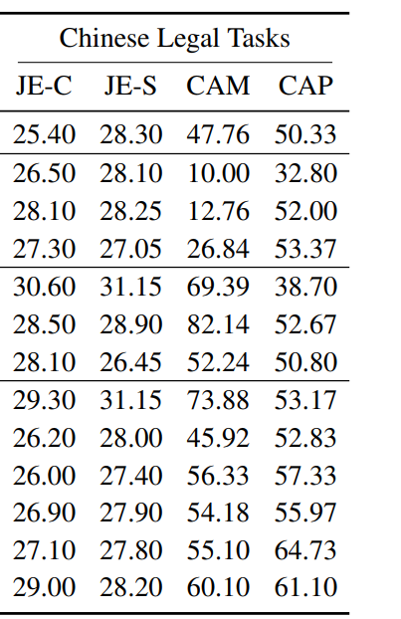
Evaluation on Chinese Legal Tasks (2/5)
Continually pre-trained on Chinese Legal Corpus can bring the model an improvement of more than +21.6% accuracy.
It shows the model can learn knowledge about marriage from the Chinese Legal Corpus.
2
29

Slide 30
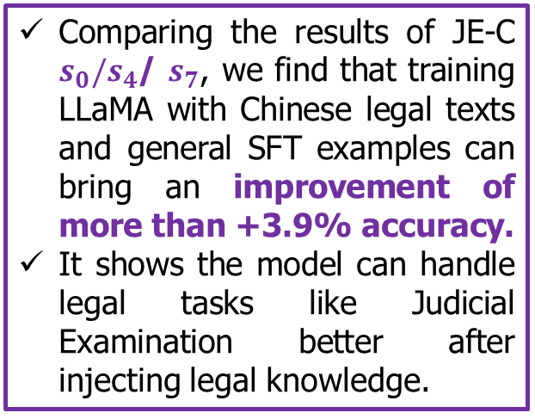
Evaluation on Chinese Legal Tasks (3/5)
Comparing the results of JE-C $s_{0}/s_{4}$/ $s_{7}$, we find that training LLaMA with Chinese legal texts and general SFT examples can bring an improvement of more than +3.9% accuracy.
It shows the model can handle legal tasks like Judicial Examination better after injecting legal knowledge.
2
30

Slide 31
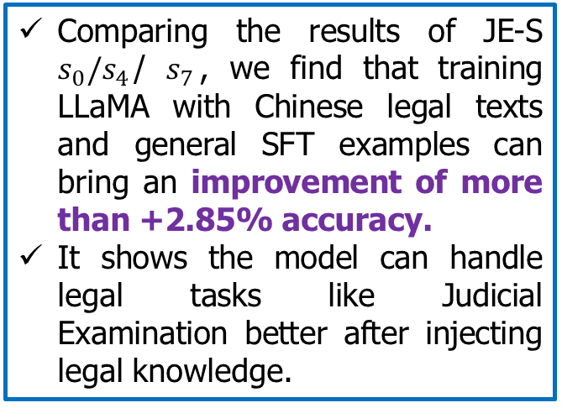
Evaluation on Chinese Legal Tasks (4/5)
Comparing the results of JE-S $s_{0}/s_{4}$/ $s_{7}$, we find that training LLaMA with Chinese legal texts and general SFT examples can bring an improvement of more than +2.85% accuracy.
It shows the model can handle legal tasks like Judicial Examination better after injecting legal knowledge.
2
31

Slide 32
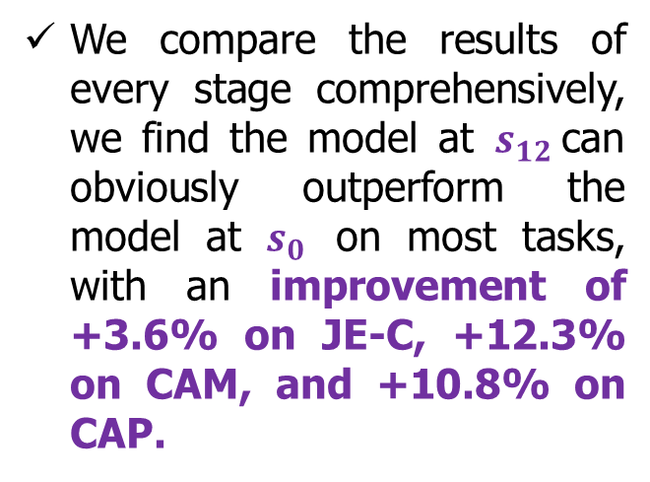
Evaluation on Chinese Legal Tasks (5/5)
We compare the results of every stage comprehensively, we find the model at $s_{12}$can obviously outperform the model at $s_{0}$ on most tasks, with an improvement of +3.6% on JE-C, +12.3% on CAM, and +10.8% on CAP.
2
32

Slide 33
Contents
Background and Contribution
Data Collection
Training Process
Experiments
Conclusion and Future Works
33

Slide 34
Conclusion
The paper proposes a method of applying Large Language Models (LLMs) like LLaMA to specific domains, such as the legal domain.
They emphasize the importance of designing proper supervised fine-tune tasks to help the model tackle practical issues in the legal domain.
The paper suggests the use of a retrieval module to extract relevant articles and enhance response reliability by addressing hallucination during model generation.
34

Slide 35
Future Works
Further exploration of injecting domain knowledge during the continual training stage to enhance the model's performance in the legal domain.
Designing more specific supervised fine-tune tasks to address practical legal issues and improve the model's ability to solve domain-related problems.
Continuous training on various types of data to monitor the model's development of NLP task-solving skills.
35

Slide 36
What data was collected and analyzed for this paper?
The paper utilizes large language models (LLMs) like LLaMA to explore the application of these models in specific domains, with a focus on the legal domain.
The authors inject domain knowledge during the continual training stage and design supervised fine-tune tasks to help the model tackle practical legal issues.
To address the hallucination problem during model generation, a retrieval module is added to extract relevant articles before the model answers queries.
36

Slide 37
What pre-training corpus is used?
The LLaMA model is pre-trained on two kinds of corpora to enhance its performance on Chinese legal consultation.
The first pre-training corpus is a general multilingual corpus, which includes articles from WuDaoCorpora, CLUECorpus2020, and the Simplified Chinese edition of Wikipedia.
The second pre-training corpus comprises Chinese legal content from China Courts' websites, including judgments, law articles, interpretations, court news, and public legal information.
37

